Slide 1


Solving Big Data Problem Using Deep Learning Models
Yijun Wei
ywei@niss.org
Yijun.Wei@nass.usda.gov
Notes:
Good morning, My name is Yijun Wei and I am going to talk about "Solving Big Data Problem Using Deep Learning Models". The projects I talked today are either ongoing project or the plan for the future so no result will be presented.

Slide 2
Disclaimer
The findings and conclusions in this presentation are those of the authors and should not be construed to represent any official USDA, or U.S. Government determination or policy
This research was supported in part by the intramural research program of the U.S. Department of Agriculture, National Agricultural Statistics Service

Slide 3
Work responsibility at USDA- National Agricultural Statistics Service (NASS)
Research Statistician at NASS (Contractor)
Research Associate at National Institute of Statistical Sciences (NISS)
Responsibility:
Conducting statistical analysis of different problems
Preparing R, SAS, Python code for different projects
Publishing papers and presenting at different conferences
Providing statistical and professional research support
Programming skills:
Python, SAS, R, tensorflow, keras, spark

Slide 4
Introduction
Introducing neural network, auto-encoder model, convolutional neural network model
Discussing two projects using deep learning models:
Ongoing project: Deep learning for data imputation using 2012 Census of Agriculture data
Future plan: Using a deep learning model for crop prediction with Crop Data Layer (CDL)

Slide 5
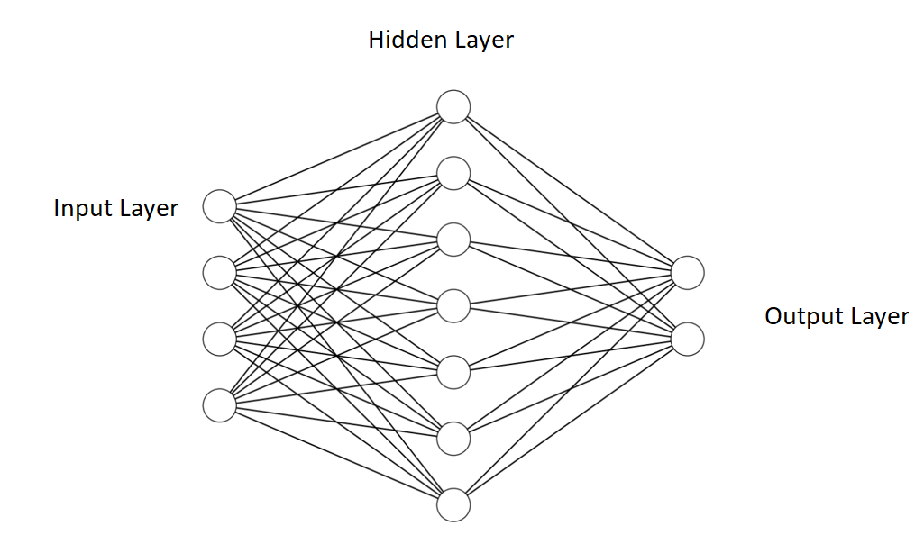
Artificial Neural Network
A simple ANN consists of 3 components, i.e. input layer, hidden layer, and output layer
Notes:
A simple ANN consists of 3 components, i.e. input layer, hidden layer, and output layer
In figure, one hidden layer is located between the input layer and output layer. There can be multiple hidden layers in an ANN but they are of the same form.

Slide 6
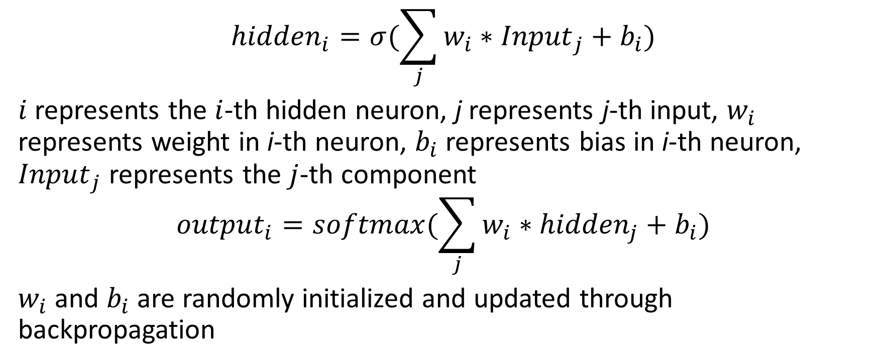
Artificial Neural Network - continued
$${hidden}_{i}=σ(\sum_{j}{w_{i}∗{Input}_{j}}+b_{i})$$
$i$ represents the $i$-th hidden neuron, j represents j-th input, $w_{i}$ represents weight in i-th neuron, $b_{i}$ represents bias in i-th neuron, ${Input}_{j}$ represents the $j$-th component
$${output}_{i}=softmax(\sum_{j}{w_{i}∗{hidden}_{j}}+b_{i})$$
$w_{i}$ and $b_{i}$ are randomly initialized and updated through backpropagation
Notes:
A hidden layer consists of several neurons and these neurons are used to form output layer. Hidden neurons in hidden layer are calculated as:
where $i$ represents the $i$-th hidden neuron, j represents j-th input, $w_{i}$ represents weight in i-th neuron, $b_{i}$ represents bias in i-th neuron, ${Input}_{j}$ represents the $j$-th component, i.e. observation, of input layer, and $σ$ is the activation function and is always set as sigmoid function.
where $i$ represents the $i$-th output, j represents j-th hidden neuro, $w_{i}$ represents weight in i-th neuron, $b_{i}$ represents bias in i-th neuron, ${hidden}_{j}$ presents the $j$-th component, i.e. observation, of hidden layer, and the activation function is softmax function. Weight $w$ and $b$ will be randomly initialized and backpropagation will be used to update weights and biases.
In the next few slides, I am going to talk about two types of Artificial Neural Network models

Slide 7
Autoencoder
Input
Output(Input)
Hidden layer
Hidden layer
Compressed feature
Encoder
Decoder
Notes:
Anautoencoder is a neural network that is trained to attempt to copy its input to its output. Internally, it has a hidden layer that describes a code used to represent the input. The network may be viewed as consisting of two parts: an encoder represents a feature extracted process and a decoder that produces a input reconstruction.This architecture is presented in ﬁgure.
Denoising autoencoders is a type of Autoencoder network that take a partially corrupted input while training to recover the original undistorted input, which is the mechanism of data imputation.

Slide 8
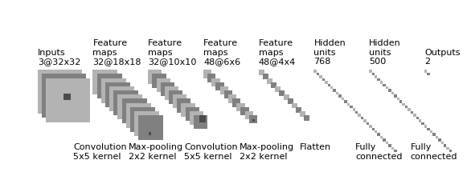
Convolutional Neural Network
CNN usually consists of multiple core layers followed by a flatten layer, and ends up with several fully connected layers followed by a softmax function to perform classification.
Most core layers have at least two components - convolutional layer, and pooling layer
Notes:
CNN is usually consisted of multiple core layers followed by a flatten layer, and ends up with several fully connected layers followed by a softmax function to perform classification. Most core layers have at least two components, i.e. convolutional layer, and pooling layer, and generates a set of features, i.e. predictors. In flatten layer, neurons are ordered as a sequence and a softmax function, i.e. classifier, is usually used following last fully connected layer for classification.
A convolutional neural network (CNN) is based on ANN and was first applied in image processing. CNN is comprised of convolutional layers, activation layers, and pooling layers followed by a small amount of fully connected layers.
an example of a complete CNN. Inputs are several 3 channels (RGB in natural image) 32*32 images. Thirty two 5*5 filters are convolved through the entire image and result in thirty two 28*28 images. After applying max-pooling using 2*2 kernel, thirty two 14*14 images are generated. Then forty eight 5*5 images are generated after being convolved by forty eight 5*5 filters and max-pooling. These forty eight 5*5 images are flattened to 1200 elements flatten layer. Two fully connected layers which have 768 and 500 respectively are followed by a softmax function to perform classification to classify outputs to 2 classes.
In the next few slides, I am going to talk about different layers of CNN.

Slide 9
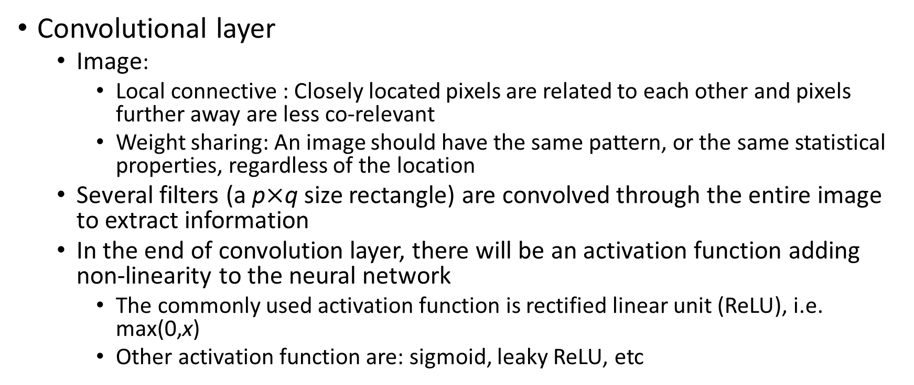
Convolutional neural network - Convolutional layer
Convolutional layer
Image:
Local connective : Closely located pixels are related to each other and pixels further away are less co-relevant
Weight sharing: An image should have the same pattern, or the same statistical properties, regardless of the location
Several filters (a p$×$q size rectangle) are convolved through the entire image to extract information
In the end of convolution layer, there will be an activation function adding non-linearity to the neural network
The commonly used activation function is rectified linear unit (ReLU), i.e. max(0,x)
Other activation function are: sigmoid, leaky ReLU, etc
Notes:
Convolutional layer is based on local connective and weight sharing of image. Consider a m$×$n pixels image where m$×$n hidden units need to be used to construct a regular neural network. If each hidden neuron in the neural network is connected to p$×$q pixels and the total number of weights will be p$×$q$×$m$×$n which is too expensive to compute. However, in an image only closely located pixels are related to each other, and pixels further away are less related to each other. Therefore, only pixels close to each other need to be considered, and this is local connective.
Objects in an image (especially in the natural image) are always related to each other, which indicates an image should have the same pattern, or the same statistical properties, regardless of the location. Therefore weights, i.e. the parameterrs that are used to convolve with pixels, can be shared through the entire image. This is called weight sharing.
Filter is defined as a p$×$q size rectangle that can be convolved through the entire input image. The dot product is computed between the entries of the filter and the image, and producing a (m-p)$×$ (n-q) activation maps of that filter. Figure in the next slide displays the convolution operation, the filter is convolved through the entire input image (4$×$4) and output a 2$×$2 smaller image with one stride.
In the end of convolution layer, there will be an activation function adding non-linearity to the neural network. If activation layer is not used, the neural network becomes a linear network and no matter how many layers are used the network will end up with the same structure.
each filter can only extract one feature, multiple filters will be convolved through the entire image to extract multiple features. All these features will be stacked along the depth dimension to form the output of the convolutional layer.

Slide 10
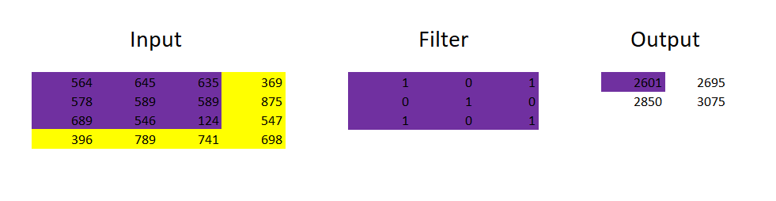
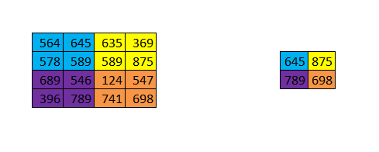
Convolutional Neural Network - continued
Convolution
Pooling

Slide 11
Convolutional neural network - continue
Pooling layer:
If all of those features are adopted to train the classifier, there will be too many weights and overfitting cannot be avoided
Subsampling (i.e. pooling) is used to handle this situation
Fully connected layer:
Stacks different neurons that connect features generated by convolutional, and pooling layers, several fully connected layers
The last fully connected layer is followed by softmax function to perform classification
Notes:
Features generated by convolutional layer need to be used to perform classification or prediction. However, if all of those features are adopted to train the classifier, which is employed to classify objects to different classes, there will be too many weights and overfitting cannot be avoided. Subsampling is used to accompany this situation. The layer which performs subsampling is named pooling layer.
As indicated previously, since pixels closed to each other tend to have the same feature, pooling layer performs non-linear subsampling to summarize the statistical properties in different image location. There are different types of pooling including max pooling and average pooling. Max pooling partitions the image into several rectangles and outputs the maximum for each region. Average pooling, similarly, outputs the average for each region. The pooling layer largely reduces the number of parameters and the computation cost of neural network and hence controls the overfitting. Max pooling is the most widely used pooling methods hence will be used in our study.
Image in the last slide displays the maximum pooling, the maximum value is taken from each block of original image and output to the pooled image.
In the fully connected layer, different neurons output from previous convolutional and pooling layers are stacked.

Slide 12
2012 Census of Agriculture
Every five years, USDA's National Agricultural Statistics Service (NASS) conducts the Census of Agriculture
The Census provides a detailed picture of U.S. farms, ranches and the people who operate them
It is the only source of uniform, comprehensive agricultural data for every state and county in the United States
NASS also obtains information on most commodities from administrative sources or surveys of non-farm populations

Slide 13
Deep Learning for Data Imputation using 2012 Census of Agriculture data
The USDA’s National Agricultural Statistics Service (NASS) surveys are affected by nonresponse and by incomplete responses that may not be homogeneous across farm types and sizes
To address unit nonresponse (incomplete responses) and some other sources of error, NASS currently uses a set of generalized linear regression models to estimate the number of US farms by calibrating their corresponding weights
Linear models only explore the linear relationship of the population and non-linear relationships are not presented
Notes:
The USDA’s National Agricultural Statistics Service (NASS) surveys are affected by nonresponse and by incomplete responses that may not be homogeneous across farm types and sizes. To address item nonresponse, NASS employs a variety of imputation methods such as ratio imputation, iterative sequential regression, fully conditional specification, K-nearest neighbor, carry forward of previously reported data and manual imputation to provide reliable and consistent values on NASS data. To address unit nonresponse and some other sources of error, NASS currently uses a set of generalized linear regression models to estimate the number of US farms by calibrating their corresponding weights. However, linear models cannot always capture important nonlinear features of the population.
Deep learning (including artificial neural network) models are used successfully in numerous other applications in order to capture nonlinear properties efficiently. Therefore is tested in the 2012 using Census of Agriculture data.
these removed values are used as the ground truth to evaluate the performance of the dep learning model.
#After imputation, a unified deep learning method (based on traditional artificial neural networks and auto-encoder techniques) is proposed to simultaneously adjust survey weights and impute missing values. Adjustments take into account #coverage, nonresponse and misclassification. Based on USDA survey data, simulation studies with split samples for training and testing are employed to evaluate different deep learning models with respect to ground truth.

Slide 14
Autoencoder in data imputation
Autoencoder deep learning model is widely used in data imputation
Duan et al. (2016) proposes denoising autoencoder deep learning model for imputing traffic data, which collected from real traffic system
The model outperforms the autoregressive integrated moving-average model and Markov Chain Monte Carlo multiple imputation method
Gondara and Wang (2018) proposes deep denoising autoencoder model to handle missing data in various dataset in UC Irvine Machine Learning (UCI) repository
The model outperforms the popular multivariate imputation by chained equations
Notes:
Traffic data collected from real traffic system always have corrupted or missing points due to monitor’s malfunction. Traffic data imputation is to estimate the corrupted or missing traffic data points. Multiple approaches, for example, autoregressive integrated moving-average model (Nihan, 1997), and Markov Chain Monte Carlo multiple imputation method (Ni and Lenard, 2005), have been used to impute the missing data and correct the corrupted data. However, with the increasing quality and quantity of the traffic data, an automatic and more efficient model should be developed to handle massive traffic data.
Therefore, Duan et al. (2016) proposed denoising stacked autoencoder deep learning model to deal with traffic data imputation and the performance of the model is found to outperform that of autoregressive integrated moving-average model and Markov Chain Monte Carlo multiple imputation method in terms of imputation accuracy. The disadvantage of deep learning model is it is difficult to explain the model but in the study Duan et al. (2016) explained the denoising stacked autoencoder model by visualization.
In Gondara and Wang (2018), a multiple imputation model based on deep denoising autoencoder model is proposed to handle missing data. Unlike previous studies, which employs the complete observations in training and only deals with the same type of missing mechanism (for example, missing at random), the proposed approach is designed to handle multiple missing mechanisms in the incomplete observation training dataset. The proposed approach is tested in different dataset which is modified by various missing mechanisms and the performance of the approach is better than that of multivariate imputation by chained equations.

Slide 15
Using Deep Learning Model for Crop Prediction in Cropland Data Layer (CDL)
CDL is a data product to identify agriculture type and location
The inputs of CDL are satellite images and USDA Farm Service Agency (FSA) Common Land Unit (CLU) data
Satellite images are used as the predictors and USDA FSA CLU data is used as the ground truth
Decision tree model is used to fit the satellite images and predict areas that are not covered by USDA FSA CLU data
A Convolutional Neural Network (CNN) will be used to replace decision tree model for more accuracy and efficiency
Notes:
Satellite images : resolution 30m
The main source of agricultural ground truth for the CDL supervised classification training is the USDA’s FSA CLU data. This standardized GIS data layer of the nation’s farms and fields was established to support farm commodity, conservation programs and disaster response (Heard 2002, Anderson et al. 2005). CLU data are updated every growing season when producers report crop type and crop acreage for Figure 2. Indian remote sensing satellite resources at 1 – Advanced Wide Field Sensor imagery acquired on 2 August 2009. Acquisition descriptions include path/row/quad information. The brightly coloured quads are those used in CDL processing. 346 C. Boryan et al. their fields to FSA county offices. The FSA CLU program is operational in over 2300 FSA county offices. The program includes all states and extensive coverage of ‘major crops’, which are those for which farmers receive financial subsidies. T

Slide 16
Expected results
As successfully applied in a number areas, denoising autoencoder deep learning model should work better than linear model in data imputation in 2012 census of agriculture data
Using CNN deep learning model is expected to outperform the decision tree model since the spatial information is considered

Slide 17
Reference
Boryan, C., Yang, Z., Mueller, R., & Craig, M. (2011). Monitoring US agriculture: the US department of agriculture, national agricultural statistics service, cropland data layer program. Geocarto International, 26(5), 341-358.
Gondara, Lovedeep & Wang, Ke. (2018). MIDA: Multiple Imputation using Denoising Autoencoders. arXiv:1705.02737.
Duan, Y., Lv, Y., Liu, Y. L., & Wang, F. Y. (2016). An efficient realization of deep learning for traffic data imputation. Transportation research part C: emerging technologies, 72, 168-181.
Nihan, N.L., 1997. Aid to determining freeway metering rates and detecting loop errors. J. Transp. Eng. 123, 454–458
Ni, D., Leonard, J.D., Guin, A., Feng, C., 2005. Multiple imputation scheme for overcoming the missing values and variability issues in ITS data. J. Transp. Eng. 131, 931–938.
Simonyan, K., & Zisserman, A. (2014). Very deep convolutional networks for large-scale image recognition. arXiv preprint arXiv:1409.1556.

Slide 18
Any Questions?

